Slide 1
Java Programming
Coding Standard and JUnit
Module 10
Notes:
1

Slide 2
Agenda
1
File Organization
2
Naming Conventions
3
Documentation
4
Formatting
5
Java Beans

Slide 3
Agenda (Contd.).
6
Introduction to JUnit
7
JUnit with Eclipse
8
Assert methods and Annotations
9
Parameterized test
10
Test Suite
Notes:
3

Slide 4
Objectives
In this module, you will be able to:
Implement Naming Conventions for Java
Implement Documentation Standards
Implement Formatting Standards
Implement Java Bean Conventions
Explore JUnit?
Learn about how to write Test cases?
Implement the various assert methods
Carry on Parameterized tests
Understand Test Suites

Slide 5
File Organization

Slide 6
Java Source Files
File Header
Package Declaration
Import Declarations
Class or Interface Declarations

Slide 7
File Header
Every java source file should have a file header and the file header should be the first section. File header is meant for capturing the file specific information like copyright, file name, short description, version number, created date, and modification history. File header information is meant to be automatically created by the source code control system. This is another reason why the file header should be the top section in the source file. (Rule Category: Mandatory)
/* * <Copyright information> * * <Customer specific copyright notice (if any) > * * <File Name> * * <Short Description> * * <Version Number > * * <Created Date in dd mmm yyyy format> * * <Modification History> */
Notes:
Blank slide you may use this to insert or show screenshots etc
If content is added in this slide you will need to use bulleted text

Slide 8
Package Declaration
The first non-comment line of a Java source file should be the package declaration. Package statement is mandatory for every Java source file. No Java source file should belong to the "default" package. Example of a package statement is below. (Rule Category: Mandatory)
package com.wipro.generic;
Usage of default modifier (package specific) is highly discouraged. Explicit specification of modifier signifies intent to the reader of your code. It also makes the code more modularized, secure and maintainable. As a good practice make the code as inaccessible as possible
public class Test{ //Fixed
void method1(){
System.out.println("Inside method");
} }

Slide 9
Import Declaration
Import declarations follow the package declaration. Import declarations should be grouped together by the package name. For unqualified access of the static members of the class, *static import should follow immediately after the import of all the classes, a line should be added to separate it from class imports. Within a group the import statements should be sorted lexically. A single blank line should be added to separate the groups if required.
import java.util.Date; import java.util.Timer ; import org.w3c.dom.Document ; import com.wipro.generic.CodeEncoder; import com.wipro.generic.TextConverter;
import static java.util.Calendar.AM; import static java.util.Calendar.AM_PM;

Slide 10
Classes or Interface Declarations
Class or Interface Declarations follow the import declarations section. A java source file can contain one or more class/interface declarations (a.k.a. type declarations). However, there should be at the maximum one public declaration per file. Also the public class/interface declaration should be the first declaration in a source file. Every type declaration is preceded by a documentation comment. (Rule Category: Mandatory)
import java.util.Date; import java.util.Timer ; public class SomeClass{}
class SomeOtherClass{}

Slide 11
Class / Interface Organization
Class or Interface documentation comment (/**...*/)
This is a javadoc style comment and will start on the same column as the Class or Interface statement that follows it. (Rule Category: Mandatory)
Class (static) variables (member fields)
First the public class variables, then the protected, then the default (no access modifier), and then the private static variables should be declared. (Rule Category: Optional) - Each static variable should be declared in a line by itself. (Rule Category: Mandatory)
Instance variables (member fields)
First public, then protected, then default (no access modifier), and then private instance variables should be declared. (Rule Category: Optional). Each instance variable should be declared in a line by itself. (Rule Category: Mandatory)
Static Member Inner class declarations
Each static member inner class should have a class header (javadoc comment for the class) immediately preceding it. (Rule Category: Mandatory)

Slide 12
Class / Interface Organization (Contd.).
Instance Constructors
Each constructor should have a method header (javadoc comment for the method) immediately preceding it. (Rule Category: Mandatory)
Instance Member Inner class declarations
Each instance member inner class should have a class header (javadoc comment for the class) immediately preceding it. (Rule Category: Mandatory)
Instance Methods
The methods in a class or interface should be grouped by functionality rather than by scope or accessibility. For example, a private class method can be in between two public instance methods. The goal is to make reading and understanding the code easier. (Rule Category: Optional)
Each method should be preceded by a javadoc comment explaining description of the method, return variables and parameters. (Rule Category: Mandatory)

Slide 13
Quiz
1. The first non-comment line of a java source file is
a. Package declaration
b. File header
c. import statement
d. class and interface declaration
2. Which of the following is the class or interface documentation comment?
a. //
b. /* */
c./**.. */
d. None of the above
Package declaration
/**..*/

Slide 14
Naming Conventions

Slide 15
Naming Conventions
Naming conventions make programs more understandable by making them easier to read. They can also give information about the purpose of the identifier--for example, whether it is a constant, package, or class--which can be helpful in understanding the code
Packages
Package names should be single lowercase words. Package names should not contain words containing capital letters. From the package name the keyword 'package 'should be separated by a Single Space and first column should start with package statement. For packages that will be widely distributed, unique package prefix scheme should be used. Prefix the site DNS name in reverse order to the package to make it unique. For example, ‘com.wipro’ should be used for naming packages in Wipro. (Rule Category: Mandatory)
Source Files
Source Files name should be same as Class Name (See Classes row for details). Each source file should contain only one public named class to avoid difficulties in figuring out the source file while coding and debugging. (Rule Category: Mandatory)

Slide 16
Naming Conventions (Contd.).
Classes and Interfaces
A class name should be in mixed case with the first letter capitalized and the first letter of each internal word capitalized. Class names should be nouns or noun phrases.
Try to keep your class names simple and descriptive. Use mnemonic whole words--avoid acronyms and abbreviations (unless the abbreviation is much more widely used than the long form, such as URL or HTML).
SessionBean or MessageBean should be suffixed by Bean.The Local Interface of a Session EJB should be suffixed by ‘Local’.The Local Home interface of a Session EJB should be suffixed by 'LocalHome'. Remote Interface of a Session EJB should NOT be suffixed. (Rule Category: Mandatory)
Annotations
Same as class or interface naming conventions (Rule Category: Mandatory)

Slide 17
Naming Conventions (Contd.).
Methods
A method name should be in mixed case with the first letter lowercase and the first letter of each internal word capitalized. (Rule Category: Mandatory)
Avoid using short method names(Rule Category: Mandatory)
Classes should not have non-constructor methods with the same name as the class(Rule Category: Mandatory)
Getter is a method that returns the value of an attribute. Prefix the word ‘get’ to the name of the attribute to form the name of a getter. Setter is a method that modifies the value of an attribute. Prefix the word ‘set’ to the name of the attribute to form the name of a setter. (Rule Category: Mandatory)
Methods which are expected to return a Boolean should be formed as a question which can be answered with a Boolean. (Rule Category: Mandatory)

Slide 18
Naming Conventions (Contd.).
Variables
Naming conventions are the same for instance variables, class (static) variables, variables local to a method and method parameters. They all should be in mixed case with a lowercase first letter. Internal words start with capital letters. (Rule Category: Mandatory)
Integer literals should not start with zero. Zero means that the rest of literal will be interpreted as an octal value. (Rule Category: Mandatory)
Avoid excessively long variable names (Rule Category: Mandatory)
Final Static Variables
Constants, values that do not change, should be implemented as static final attributes of classes. (Rule Category: Mandatory)
Use all upper case letters with internal words separate by underscores. (Rule Category: Mandatory)

Slide 19
Naming Convention (Contd.).
Exception Objects
Because exception handling is very common in Java, the letter ‘e’ should be used for a generic exception. However, when using multiple exception types in a single try catch block use an abbreviated name of the Exception in small case followed by ‘e’ (Rule Category: Mandatory)

Slide 20
Quiz
Which of the following are true regarding Naming Conventions?
a. The Package names should be in Capital letters
b. The Package names should be in Lowercase letters
c. Classes and interfaces should have mixed case (first letter Capital)
d. Class names should be verbs
e. Final variables should be all in lowercase
b and c are correct

Slide 21
Documentation

Slide 22
Documentation
Java language supports two types of comments: documentation and implementation comments.
Documentation comments are delimited by /** … */. Javadoc comments are meant to describe the specification of code, from an implementation free prospective to read by developers.
The other type of comments includes two other styles, which are delimited by /* … */ and //.
These types of comments are used either for explaining the developers thinking behind a particular piece of code or to comment out unused code.

Slide 23
Documentation Comments
Always first line comment should be in simple characters /** without any text on the line and should be aligned with the following declared entity.
Remaining lines may consists of an asterisk, single space, comment text and aligned with the first asterisk of the first line.
Comment text in the beginning sentence is special and should be a self contained summary sentence. (Rule Category: Mandatory)
Class and interface comments can use the @version, @author, and @see tags, in that order. If there are multiple authors, use a separate @author tag for each one. Required tags: @version, @author tags. (Rule Category: Mandatory)
Constructor comments can use the @param, @exception, and @see tags, in that order. Required tags: one @param tag for each parameter and one @exception tag for each exception thrown. (Rule Category: Mandatory)

Slide 24
Documentation Comments (Contd.).
Method comments can use the @param, @return, @exception, and @see tags, in that order. Required tags: one @param tag for each parameter, one @return tag if the return type is not void, and one @exception tag for each exception thrown. (Rule Category: Mandatory)
Variable comments can use any javadoc tags, which are applicable, should be used. These javadoc tags are @values, @concurrency, @see, @example, @fyi, etc. Required tags: none. (Rule Category: Mandatory)

Slide 25
Comments for Class or Interface
/** * A facility for threads to schedule tasks for future execution in a background thread. Tasks may * be scheduled for one-time execution, or for repeated execution at regular intervals. * * <p>If the timer's task execution thread terminates unexpectedly, for example, because its * <tt>stop</tt> method is invoked, any further attempt to schedule a task on the timer will * result in an <tt>IllegalStateException</tt>, as if the timer's <tt>cancel</tt> method had * been invoked. * * <p>This class is thread-safe: multiple threads can share a single <tt>Timer</tt> object without * the need for external synchronization. * * <p>Implementation note: This class scales to large numbers of concurrently scheduled tasks * (thousands should present no problem). Internally, it uses a binary heap to represent its * task queue, so the cost to schedule a task is O(log n), where n is the number of concurrently * scheduled tasks. * * @author Josh Bloch * @version 1.9, 01/23/03 * @see TimerTask * @see Object#wait(long) * @since 1.3 */ public class Timer {

Slide 26
Comments for method
/** * Checks a object for “coolness”. Performs a comprehensive * coolness analysis on the object. An object is cool if it * inherited coolness from its parent; however, an object can * also establish coolness in its own right. * * @param obj the object to check for coolness * @param name the name of the object * @return true if the object is cool; false otherwise. * @exception OutOfMemoryError If there is not enough memory to * determine coolness. * @exception SecurityException If the security manager cannot be * created * @see isUncool * @see isHip */ public boolean isCool(Object obj, String name) throws OutOfMemoryError, SecurityException {

Slide 27
Block Comments
A regular block comment starts with the characters /* and ends with the characters */. A block comment should be preceded by a blank line to set it apart from the rest of the code. (Rule Category: Mandatory) Block comments have an asterisk "*" at the beginning of each line except the first.
/*
* Look for preexisting entry for key. This will never happen for clone
* or deserialize. It will only happen for construction if the input Map
* is a sorted map whose ordering is inconsistent w/ equals.
*/
for (Entry e = table[i]; e != null; e = e.next) {
if (e.hash == hash && eq(k, e.key)) {
e.value = value;
return;
}
}

Slide 28
Java Documentation
Javadoc Method
Java documentation should not contain syntax errors. (Rule Category: Mandatory)
Use the correct syntax for the @throws tag:
/** @throws exception_class_name text */
public class SampleFixed {
/** @throws IOException */ // FIXED
FileInputStream openFile (String path) throws IOException{
System.in.read ();
return null;
}
/** @throws $none */ // FIXED
static void method () { }
}

Slide 29
@ return tag in Javadoc Method
Every method which returns a data type should contain @return statement in the java documentation. (Rule Category:Mandatory)
public class Sample {
/**
* This method print the message and return the integer value. * @return int - of value. // FIXED
*/
public int SampleMethod() {
int a = 10;
//To-Do (implementattion for "Sample");
return a*a;
}
}

Slide 30
@ param tag in Javadoc Method (Contd.).
In any public method written in the java code which contains parameters, the java documentation should contain @param tag for specifying the parameters used in the method. (Rule Category : Mandatory)
public class ParamTest {
/**
* This method print the message and return the integer value. * @param b - Takes the int value as parameter // FIXED */
public void SampleMethod(int b) {
int a = b;
//To-Do (implementattion for "Param Value :" + a);
}
}

Slide 31
Formatting

Slide 32
Indentation
One of the ways to improve the code readability is to group the individual statements into block statements and uniformly indent the content of each block to set off its contents from the surrounding code. Nested code should be indented one further level than the parent block. (Rule Category: Mandatory)
Four spaces should be used as the unit of indentation. Most of the IDE tools allow the interpretation of tab for indentation. In such cases set the tab size to 4. If the IDE doesn’t support tab to white space interpretation do not use the tab character for indentation. Four spaces are generally accepted as the indentation size. However this can be configured on a project basis if there is a strong reason to do so.(Rule Category: Mandatory)

Slide 33
Wrapping Lines
The length of a line should not be more than 80 characters. 80 characters of line size is generally accepted. However, it can be configured on a project basis if there is strong reason to do so. (Rule Category: Mandatory)
Break after a comma
Break before an operator
Align the new line with the beginning of the expression at the same level on the previous line
If the above rules lead to confusing code or to code that is squished up against the right margin, just indent 8 spaces instead
methodCall(longExpression1, longExpression2, longExpression3, longExpression4, longExpression5); //aligned with the new line var = method1(longExpression1, method2(longExpression2, longexpression3)); //indented with the new line

Slide 34
White Space Usage
Use single space immediately after right parenthesis ‘)’ or a right curly brace ‘}’ to separate any keyword that follows. Similarly a single white space should be used before the left parenthesis ‘(‘ or a left curly brace ‘{‘ when follow a keyword. (Rule Category: Mandatory)
Using single space with any binary operator, except for the “.” qualification operator and the expression that proceeds and the expression that follows the operator. (Rule Category: Mandatory) Please see the example below.
Use blank lines to separate:
Each logical section of a method implementation
Section / member of a class and / or an interface definition
double diagonal = Math.sqrt(x * x + y * y);
double norm = length > 0.0 ? (x / length) : x;

Slide 35
Curly Braces
Brace should be placed at the end of the statement on the same line (Kernighan & Ritchie style) (used as standard in this document). The closing brace should be on a line by itself aligned with the indentation level of the original statement or declaration. (Rule Category: Mandatory)

Slide 36
Java Beans

Slide 37
Java Beans Conventions
Java Bean class must be a member of a package
The Bean class should be declared as a public class
Instance variables of the bean class must be private
The bean class should provide some public access methods (get / set methods) to access the private instance variables.
Bean class must have a public zero argument constructor.

Slide 38
Quiz
Why should we follow Coding Conventions?
80% of the lifetime of a software goes in maintenance
Hardly any software is maintained for its whole life by the original author
Code conventions improve the readability of the software, allows engineers to understand the new code more quickly and thoroughly
Which of the following are correct way of declaration?
a. class eg{
}
b. interface eg{
}
c. class WiproEmployee{
}
class WiproEmployee{
}

Slide 39
Introduction to JUnit

Slide 40
Introduction
JUnit is an open source testing framework for Java
It is a simple framework for creating automated unit tests
JUnit test cases are Java classes that contain one or more unit test methods
These tests are grouped into test suites
JUnit tests are pass/fail tests explicitly designed to run without human intervention
JUnit can be integrated with several IDEs, including Eclipse
The JUnit distribution can be downloaded as a single jar file from http://www.junit.org
It has to be kept in the classpath of the application to be tested
Notes:
Unit Testing
A unit test is a piece of code written by a developer that executes a specific functionality in the code under test. Unit tests ensure that code is working as intended and validate that this is still the case after code changes.
Unit Testing with JUnit
JUnit 4.x is a test framework which uses annotations to identify methods that are tests. JUnit assumes that all test methods can be executed in an arbitrary order. Therefore tests should not depend on other tests.
Installation of JUnit
If you use Eclipse you can use the integrated JUnit in Eclipse for your testing.
If you want to control the used JUnit library explicitly, download JUnit4.x.jar from the JUnit website at http://www.junit.org/ . The download contains the "junit-4.*.jar" which is the JUnit library. Add this library to your Java project and add it to the classpath.
40

Slide 41
JUnit with Eclipse

Slide 42
JUnit with Eclipse
Create a new Project com.wipro.JUnit
Add JUnit.jar to the Classpath
Right click the Project and create a new Source folder called ‘test’
Create a new Java class called Calculator in a package junit.first
Add 2 methods add and sub to the Calculator class which does addition and subtraction of 2 numbers respectively
package junit.first;
public class Calculator {
public int add(int x,int y)
{ return x+y; }
public int sub(int x,int y)
{ return x-y; } }
Notes:
42

Slide 43
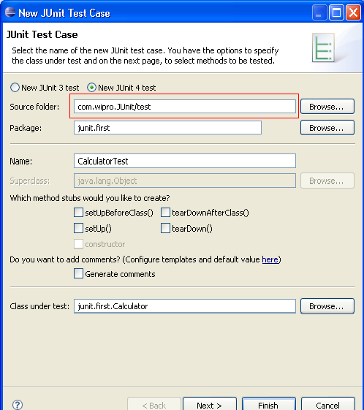
JUnit with Eclipse (Contd.).
Right click on the Calculator class in the Package Explorer and
select New->JUnitTestCase
select "New JUnit4 test“
set the source folder to "test“ – the test class gets created here
Notes:
43

Slide 44
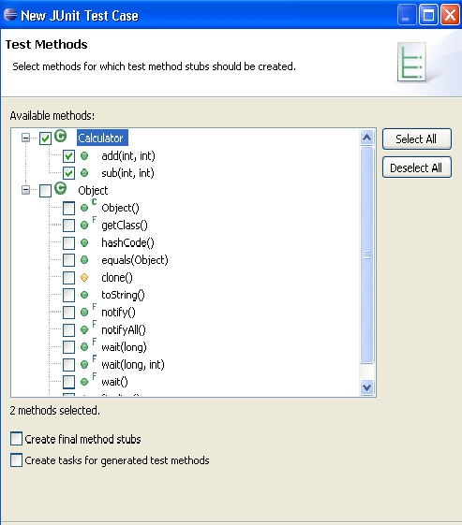
JUnit with Eclipse (Contd.).
Press "Next" and select the methods you want to test
Select the required methods
Notes:
44

Slide 45
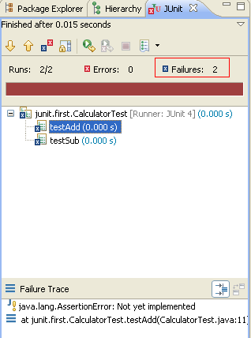
JUnit with Eclipse (Contd.).
Right click on CalculatorTest class and select
Run-As → JUnit Test
The results of the test will be displayed in JUnit view
This is because the testAdd and testSub are not implemented correctly
Brown color indicates failure
Notes:
45

Slide 46
How to write a JUnit test method
All the test methods should be marked with the JUnit annotation - @org.junit.Test
All the JUnit test methods should be "public" methods
The return type of the JUnit test method must be “void"
The test method need not start with the test keyword
Here is a simple JUnit test method:
@Test
public void testAdd()
{
Calculator c=new Calculator();
assertEquals("Result",5,c.add(2,3));
}
Notes:
46

Slide 47
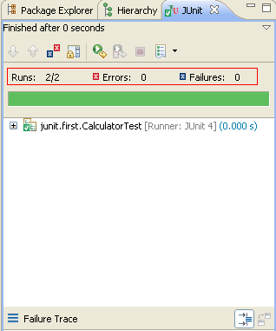
JUnit with Eclipse
Now let’s provide implementation to the code and run the test again
package junit.first;
import static org.junit.Assert.*;
import org.junit.Test;
public class CalculatorTest {
@Test
public void testAdd() {
Calculator c=new Calculator();
assertEquals(5,c.add(2,3));
}
@Test
public void testSub() {
Calculator c=new Calculator();
assertEquals(20,c.sub(100,80));
} }
Green color indicates pass
Notes:
Unit tests are implemented as classes with test methods. Each test method usually tests a single method of the target class. Sometimes, a test method can test more than one method in the target class, and sometimes, if the method to test is big, you split the test into multiple test methods.
The unit test class is an ordinary class, with two methods, tesAdd() and testSub. Notice how this method is annotated with the JUnit annotation @Test. This is done to signal to the unit test runner, that this is method represents a unit test, that should be executed. Methods that are not annotated with @Test are not executed by the test runner.
Inside the testAdd() method an instance of Calculator is created. Then it's add() method is called with two integer values.
Finally, the assertEquals() method is called. It is this method that does the actual testing. In this method we compare the output of the called method (add()) with the expected output.
If the two values are equal, nothing happens. The assertEquals() method returns normally. If the two values are not equal, an exception is thrown, and the test method stops executing here.
The assertEquals() method is a statically imported method, which normally resides in the org.junit.Assert class. Notice the static import of this class at the top of MyUnitTest. Using the static import of the method is shorter than writing Assert.assertEquals().
47

Slide 48
Assert methods and Annotations
Notes:
48

Slide 49
Assert methods with JUnit
assertArrayEquals()
Used to test if two arrays are equal to each other
int[] expectedArray = {100,200,300};
int[] resultArray = myClass.getTheIntArray();
assertArrayEquals(expectedArray, resultArray);
assertEquals()
It compares two objects for their equality
String result = myClass.concat("Hello", "World");
assertEquals("HelloWorld", result);
assertEquals(“Reason for failure”,”HelloWorld”,result);
Will get printed if the test will fail
Note: All assert methods are static methods,
hence one has to use static import
import static org.junit.Assert.*;
Notes:
assertArrayEquals()
Used to test if two arrays are equal to each other. If the arrays are equal, the assertArrayEquals() will proceed without errors. If the arrays are not equal, an exception will be thrown, and the test aborted. Any test code after the assertArrayEquals() will not be executed.
assertEquals
The assertEquals() method can compare any two objects to each other. If the two objects compared are not same, then an AssertionError will be thrown.
49

Slide 50
Notes:
The new assertEquals methods use Autoboxing, and hence all the assertEquals(primitive, primitive) methods will be tested as assertEquals(Object, Object). This may lead to some interesting results. For example autoboxing will convert all numbers to the Integer class, so an Integer(10) may not be equal to Long(10). This has to be considered when writing tests for arithmetic methods. For example, the following Calc class and it’s corresponding test CalcTest will give you an error.
public class Calc {
public long add(int a, int b) {
return a+b;
}
}
import org.junit.Test;
import static org.junit.Assert.assertEquals;
public class CalcTest {
@Test
public void testAdd() {
assertEquals(5, new Calc().add(2, 3));
}
}
You will end up with the following error.
java.lang.AssertionError: expected:&lt;5&gt; but was:&lt;5&gt;
This is due to autoboxing. By default all the integers are cast to Integer, but we were expecting long here. Hence the error. In order to overcome this problem, it is better if you type cast the first parameter in the assertEquals to the appropriate return type for the tested method as follows
assertEquals((long)5, new Calc().add(2, 3));

Slide 51
Assert methods with JUnit (Contd.).
assertTrue() , assertFalse()
Used to test a variable to see if its value is true, or false
assertTrue (testClass.isSafe());
assertFalse(testClass.isSafe());
assertNull(),assertNotNull()
Used to test a variable to see if it is null or not null
assertNull(testClass.getObject());
assertNotNull(testClass.getObject());
assertSame() and assertNotSame()
Used to test if two object references point to the same object or not
String s1="Hello";
String s2="Hello";
assertSame(s1,s2); ->true
Notes:
assertTrue() , assertFalse()
If the isSafe() method returns true, the assertTrue() method will return normally. Else an exception will be thrown, and the test will stop there.
If the isSafe() method returns false, the assertFalse() method will return normally. Else an exception will be thrown, and the test will stop there.
assertNull(),assertNotNull()
If the testClass.getObject() returns null, the assertNull() method will return normally, else the assertNull() method will throw an exception, and the test will be stopped.
The assertNotNull() method works oppositely of the assertNull() method. It throws an exception if a null value is passed to it, and returns normally if a non-null value is passed to it.
assertSame(),assertNotSame()
Used to check if two object references point to the same object or not.
51

Slide 52
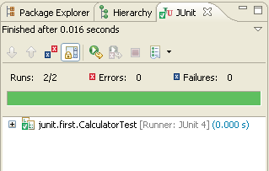
Annotations
Fixtures
The set of common resources or data that you need to run one or more tests
@Before
It is used to call the annotated function before running each of the tests
@After
It is used to call the annotated function after each test method
public class CalculatorTest {
Calculator c=null;
@Before
public void before()
{
System.out.println("Before Test");
c=new Calculator();
}
@After
public void after()
{
System.out.println("After Test"); }
@Test
public void testAdd() {
System.out.println("Add function");
assertEquals("Result",5,c.add(2,3));
}
@Test
public void testSub() {
System.out.println("Sub function");
assertEquals("Result",20,c.sub(100,80));
} }
O/P :
Before Test
Add function
After Test
Before Test
Sub function
After Test
Notes:
Let's consider the case in which each of the tests that you design needs a common set of objects. One approach can be to create those objects in each of the methods. Alternatively, the JUnit framework provides two special methods, setUp() and tearDown(), to initialize and clean up any common objects. This avoids duplicating the test code necessary to do the common setup and cleanup tasks. These are together referred to as fixtures. The framework calls the setup() before and tearDown() after each test method—thereby ensuring that there are no side effects from one test run to the next.
In Junit 4.x the @Before annotation does the role of the setUp() method and the @After annotation performs the role of the tearDown() method of JUnit 3.x
52

Slide 53
Annotations (Contd.).
@BeforeClass
The annotated method will run before executing any of the test method
The method has to be static
@AfterClass
The annotated method will run after executing all the test methods
The method has to be static
public class CalculatorTest {
static Calculator c=null;
@BeforeClass
public static void before()
{
System.out.println("Before Test");
c=new Calculator();
}
@AfterClass
public static void after()
{
System.out.println("After Test");
}
@Test
public void testAdd() {
System.out.println("Add function");
assertEquals("Result",5,c.add(2,3));
}
@Test
public void testSub() {
System.out.println("Sub function");
assertEquals("Result",20,c.sub(100,80));
}
}
O/P :
Before Test
Add function
Sub function
After Test
Notes:
@BeforeClass and @AfterClass Use @BeforeClass and @AfterClass annotations for class wide “setup” and “tearDown” respectively. Think them as one time setup and tearDown. They run for one time before and after all test cases.
53

Slide 54
Annotations (Contd.).
@Ignore
Used for test cases you wanted to ignore
A String parameter can be added to define the reason for ignorance
@Ignore(“Not Ready to Run”)
@Test
public void testComuteTax() { }
@Test
Used to identify that a method is a test method
Notes:
Two optional parameters are supported by Test Annotation.
The first optional parameter ‘expected’ is used to declare that a test method should throw an exception. If it doesn't throw an exception or if it throws a different exception than the one declared, the test fails. For example, the following test succeeds:
@Test(expected=IndexOutOfBoundsException.class)
public void checkOutOfBounds()
{
new ArrayList<String>().get(1);
}
The second optional parameter, ‘timeout’, causes a test to fail if it takes longer than a specified amount of clock time (measured in milliseconds). The following test fails:
@Test(timeout=1000)
public void infinityCheck()
{
while(true);
}
54

Slide 55
Annotations (Contd.).
Timeout
It defines a timeout period in miliseconds with “timeout” parameter
The test fails when the timeout period exceeds.
@Test (timeout = 1000) public void testinfinity() { while (true) ; }
Notes:
55

Slide 56
Parameterized test

Slide 57
Parameterised Tests
New feature added in JUnit 4
Used to test a method with varying number of Parameters
Steps for testing a code with multiple parameters
The testing class should be annotated with @RunWith(Parameterized.class)
The class should have these 3 entities
A single constructor that stores the test data
Is expected to store each data set in the class fields
A static method that generates and returns test data
This should be annotated with @Parameters
It should return a Collection of Arrays
Each array represent the data to be used in a particular test run
Number of elements in an array should correspond to the number of elements in the constructor
Because each array element will be passed to the constructor for every run
A test method
Notes:
Structure of a parameterized test class
The method that generates test data must be annotated with @Parameters, and it must return a Collection of Arrays. Each array represents the data to be used in a particular test run. The number of elements in each array must correspond to the number of parameters in the class's constructor, because each array element will be passed to the constructor, one at a time as the class is instantiated over and over.
The constructor is simply expected to store each data set in the class's fields, where they can be accessed by the test methods. Note that only a single constructor may be provided. This means that each array provided by the data-generating method must be the same size, and you might have to pad your data sets with nulls if you don't always need a particular value.
Let's put this together. When the test runner is invoked, the data-generating method will be executed, and it will return a Collection of Arrays, where each array is a set of test data. The test runner will then instantiate the class and pass the first set of test data to the constructor. The constructor will store the data in its fields. Then each test method will be executed, and each test method will have access to that first set of test data. After each test method has executed, the object will be instantiated again, this time using the second element in the Collection of Arrays, and so on.
57

Slide 58
Notes:
package junit.first;
import junit.first.Stringmanip.*;
import java.util.Arrays;
import java.util.Collection;
import org.junit.Test;
import org.junit.runners.Parameterized;
import org.junit.runners.Parameterized.Parameters;
import org.junit.runner.RunWith;
import static org.junit.Assert.*;
@RunWith(Parameterized.class)
public class StringmanipTest2
{
// Fields
private String datum;
private String expected;
/*
Constructor.
The JUnit test runner will instantiate this class once for every element in the Collection returned by the method annotated with
@Parameters.
*/
public StringmanipTest2(String datum, String expected)
{
this.datum = datum;
this.expected = expected;
}
/*
Test data generator.
This method is called the the JUnit parameterized test runner and returns a Collection of Arrays. For each Array in the Collection, each array element corresponds to a parameter in the constructor.
*/

Slide 59
Notes:
@Parameters
public static Collection<Object[]> generateData()
{
// In this example, the parameter generator returns a List of
// arrays. Each array has two elements: { datum, expected }.
// These data are hard-coded into the class, but they could be
// generated or loaded in any way you like.
Object[][] data = new Object[][]{
{ "Anitha", "ANITHA" },
{ "anitha", "ANITHA" },
{ "ANITHA", "ANITHA" }
};
return Arrays.asList(data);
}
/*
The test.
This test method is run once for each element in the Collection returned by the test data generator -- that is, every time this class is instantiated. Each time this class is instantiated, it will have a different data set, which is available to the test method through the
instance's fields.
*/
@Test
public void testUpperCase()
{
Stringmanip s = new Stringmanip(this.datum);
String actualResult = s.upperCase();
assertEquals(actualResult, this.expected);
}
}

Slide 60
Handling an Exception
Two cases are there:
Case 1 :We expect a normal behavior and then no exceptions
Case 2: We expect an anomalous behavior and then an exception
Case 1:
@Test
public void testDiv()
{
try
{
c.div(10,2);
assertTrue(true); //OK
}catch(ArithmeticException expected)
{
fail("Method should not fail");
}}
Case 2:
@Test
public void testDiv()
{
try
{
c.div(10,0);
fail("Method should fail");
}catch(ArithmeticException expected)
{
assertTrue(true);
} }
public void div(int a,int b)throws ArithmeticException
{
int c=0;
c=a/b;
System.out.println(c);}

Slide 61
Test Suite

Slide 62
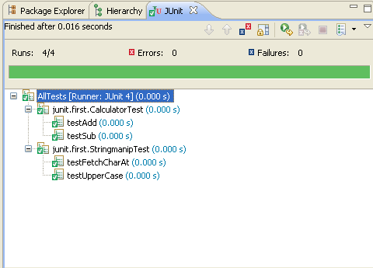
Test Suite
Convenient way to group together tests that are related
Used to bundle a few unit test cases and run it together
Annotations used for this
@RunWith
Used to invoke the class which
is annotated to run the tests
in that class
@Suite
Allows you to manually build a
suite containing tests from many
classes
@RunWith(Suite.class)
@SuiteClasses({
CalculatorTest.class,
StringmanipTest.class
})
public class AllTests {
}
Notes:
When a class is annotated with @RunWith,JUnit will invoke the class it references to run the tests in that class.
Using Suite as a runner allows you to manually build a suite containing tests from many classes.
Example:-
Calculator.java
--------------------
package junit.first;
public class Calculator {
public int add(int x,int y)
{
return x+y;
}
public int sub(int x,int y)
{
return x-y;
}
}
62

Slide 63
Quiz
1. Which of the following annotations has to be used before each of the test method?
a. @Before
b. @BeforeClass
c. @After
d. None of the above
2. Which of the following are true?
a. All assert methods are static methods
b. The JUnit test methods can be private
c. The JUnit test methods should start with the test keyword
d. All of the above true
None of the above
All assert methods are static methods

Slide 64
Summary
In this module, you were able to
Implement Naming Conventions for Java
Implement Documentation Standards
Implement Formatting Standards
Implement Java Bean Conventions
Explore JUnit?
Learn about how to write Test cases?
Implement the various assert methods
Carry on Parameterized tests
Understand Test Suites

Slide 65
References
Sun Microsytems. Java Coding Stye Guide. Retrieved on April 10, 2012 from, http:// developers.sun.com/sunstudio/products
2. Vincent Massol and Ted Husted. JUnit in Action. Ed 2. UK: Manning publications co., 2003.

Slide 66
Thank You

